Slide 1
E-COMMERCE ANALYSIS POWER BI
BY
AARTHI KRISHNAN

Slide 2
OBJECTIVE
This report provides a comprehensive analysis of the e-commerce sales data, helping stakeholders understand customer behavior, sales trends, and operational performance. It is designed to support data-driven decisions, optimize marketing efforts, and boost revenue.

Slide 3
KEY METRICS
SALES PERFORMANCE
CUSTOMER INSIGHTS
ORDER INSIGHTS
REVENUE ANALYSIS
GEOGRAPHICAL INSIGHTS

Slide 4
INSIGHTS
TOTAL ORDER : 4308
CUSTOMER COUNT : 3660
Clothing category is the highest revenue generating category
Electronic category is the lowest revenue generating category
Order count is more for Home and Kitchen Category but still it’s revenue is less than Clothing.
Approximately every delivery mode has equal number of order count in which In person has the highest about 19% of total order.

Slide 5
ALOK Manager has the highest order count as compared to other Manager but still his total revenue generated is less than SMITH Manager
Order count and Revenue reaches the highest in the month of January.
Distributor C has the maximum order count but the revenue generated is less than I and E distributor.
China has the maximum of order count and Revenue generated.

Slide 6
CONCLUSION
This report empowers decision-makers with actionable insights to enhance sales strategies, improve customer engagement, and streamline operations. By continuously monitoring trends and performance metrics, businesses can adapt to changing market demands and improve overall profitability.

Slide 7
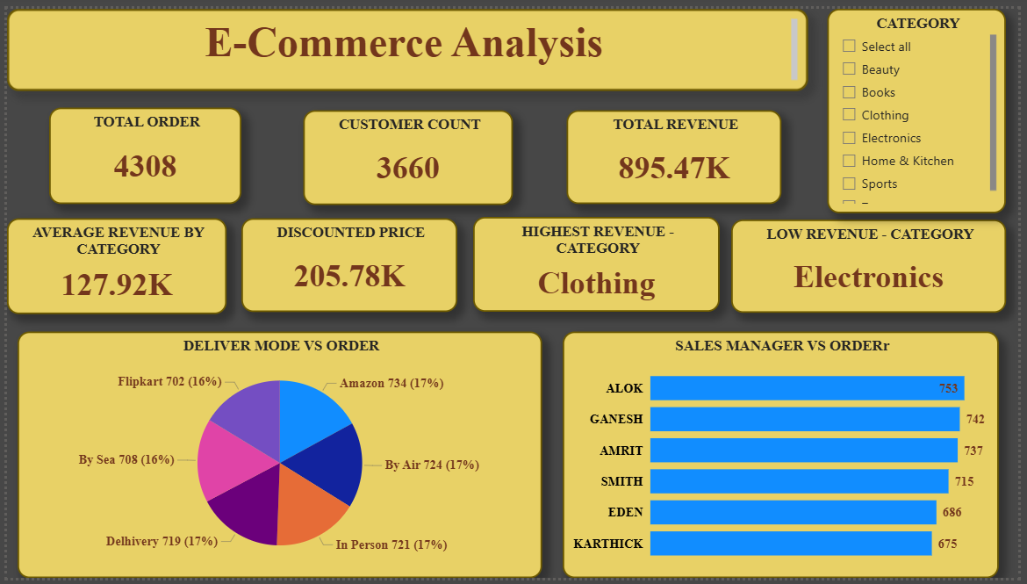

Slide 8
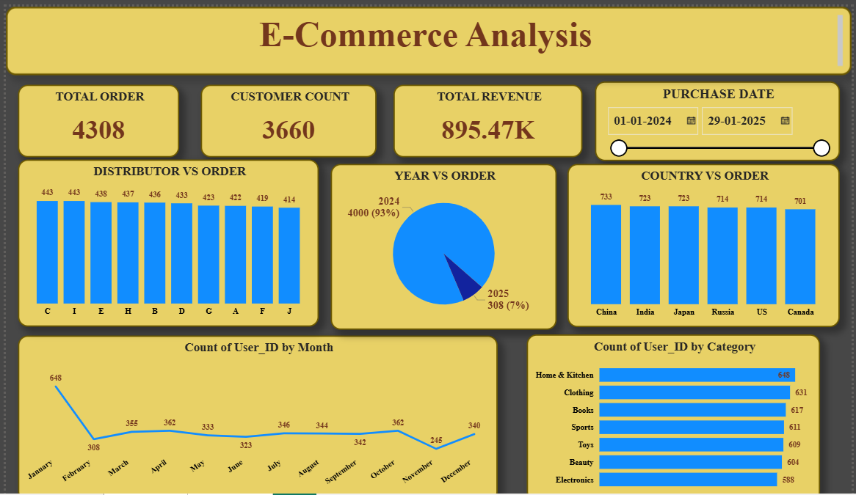

Slide 9
THANK YOU

